Slide 1
Feedforward control

Slide 2
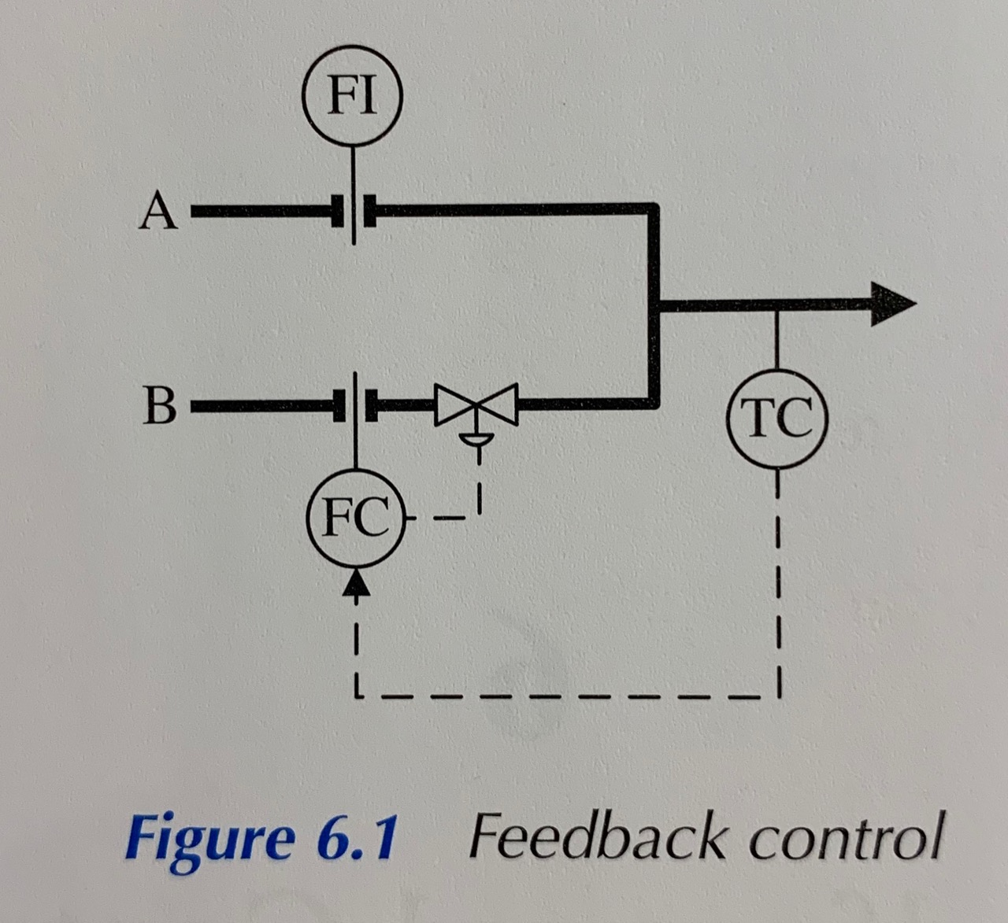
- two streams of temperatures Ta and Ta
- stream A - no control, main disturbance
Notes:
The objective is control the temperature (T) of mixture of two streams of temperatures Ta and Tb by manipulating the flow of one of them. We have no control over the flow of stream A - indeed changes in its flow are the main disturbances to the process. The feedback scheme is limited in that it can only take corrective action once it has detected a deviation from desired temperature value (setpoint - SP).

Slide 3
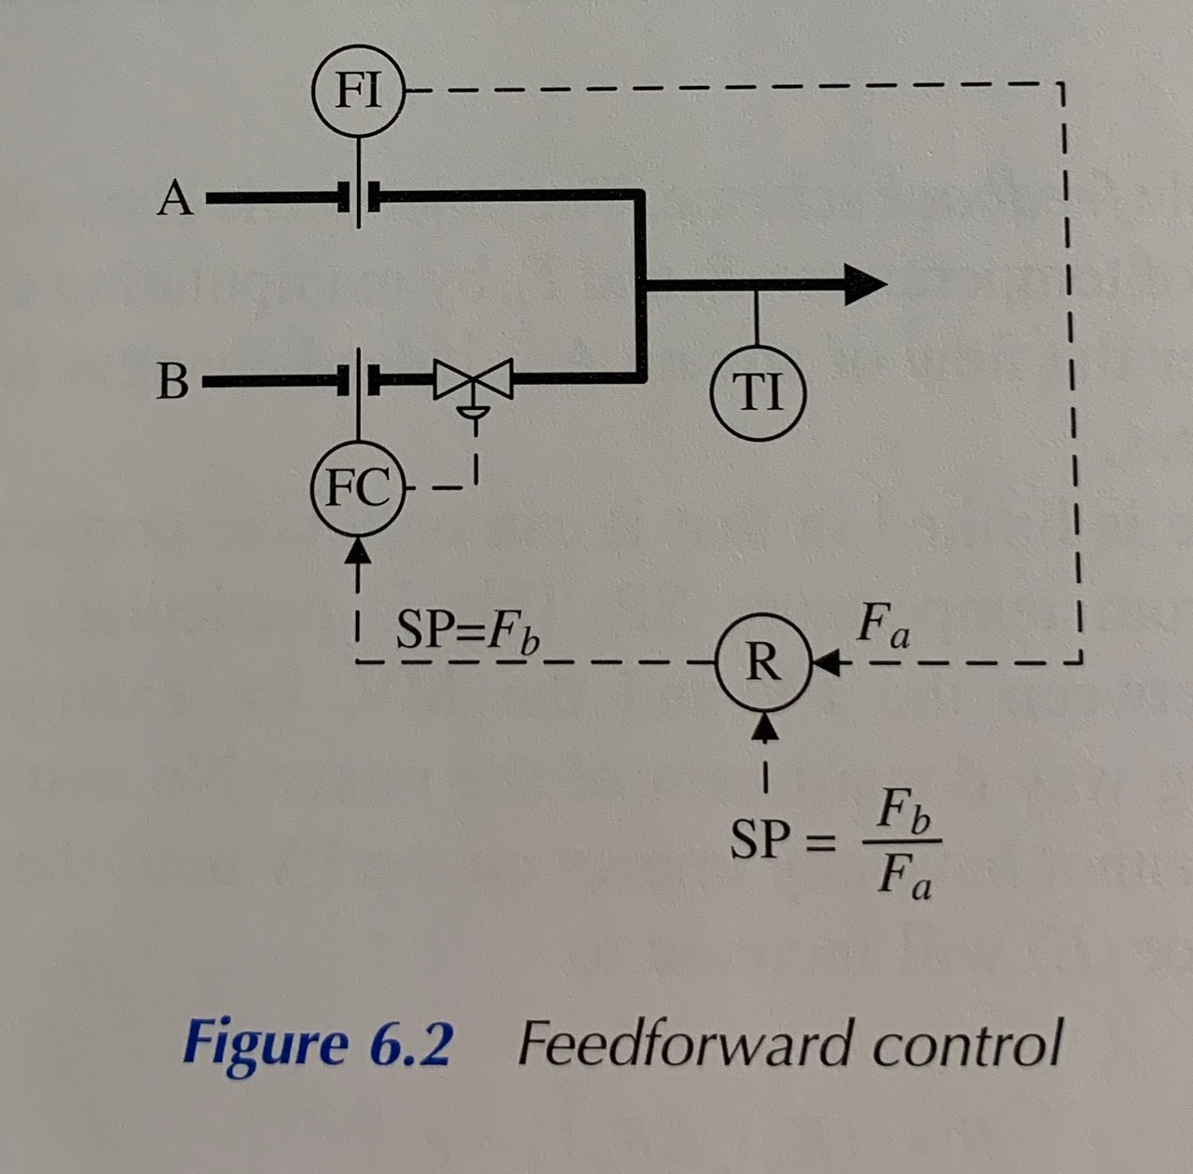
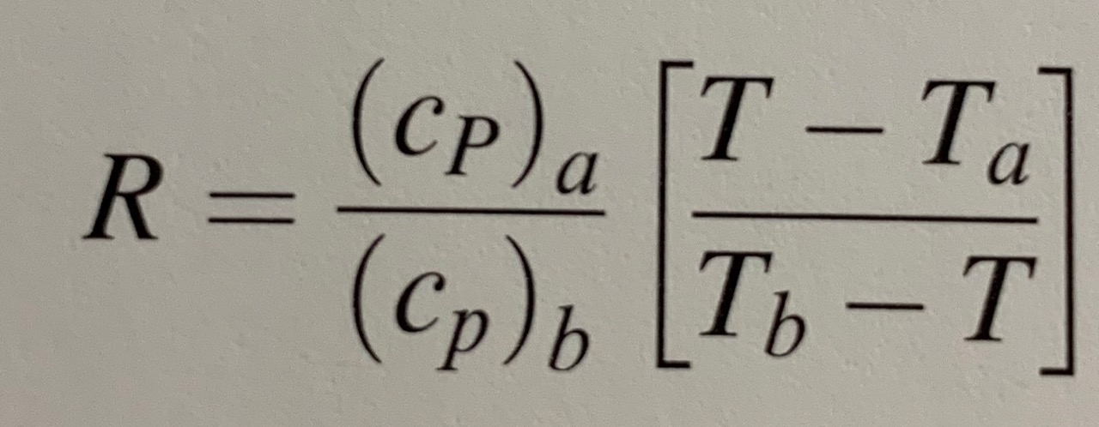
- we can introduce additional measurement - the disturbance variable (DV)
incorporate measurement of the flow of the stream A
this way we can take action before the temperature changes
R - ratio algorithm
Notes:
We can solve this issue by introducing additional measurement - known as the disturbance variable (DV). In this case, we incorporate the measurement of the flow of a stream A. By monitoring this flow we can predict that it will disturb the temperature and so can take action before the temperature changes.
To do this, we use a ratio algorithm. This algorithm generates an output by multiplying the two inputs. One input is the measured flow of stream A, the other is the operator-entered target for the ratio of the flow of stream B to stream A. As the flow of stream A changes the ratio algorithm maintains the flow of stream B in proportion, thus keeping the temperature constant. The liquids have specific heats of (cP)a and (cP)b.

